Slide 1
iPhone 7
Sandra Salazar
Stephany Ramírez
Herman Collazos

Slide 2
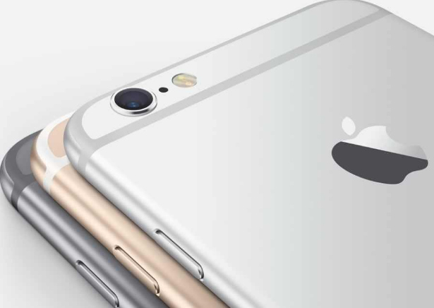
iPhone 7
iPhone 7 specifications
new OS i.e. iOS 10
screen size of 4.7 and 5.5
As far as camera is concern, iPhone 7 will sport improved 13 megapixel

Slide 3
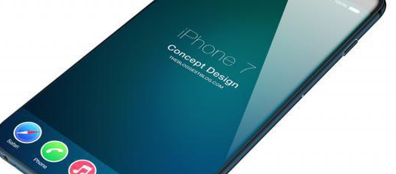
iPhone 7
the new iPhone 7 may feature Sapphire glass instead of Corning’s Gorilla glass

Slide 4
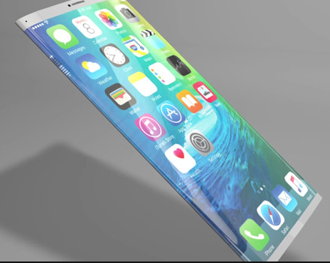
iPhone 7
The home button which is being used in current iPhone can be eliminated

Slide 5
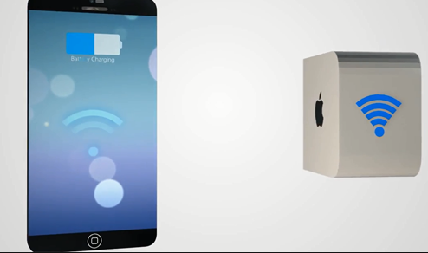
iPhone 7
iPhone 7 charge wirelessly

Slide 6
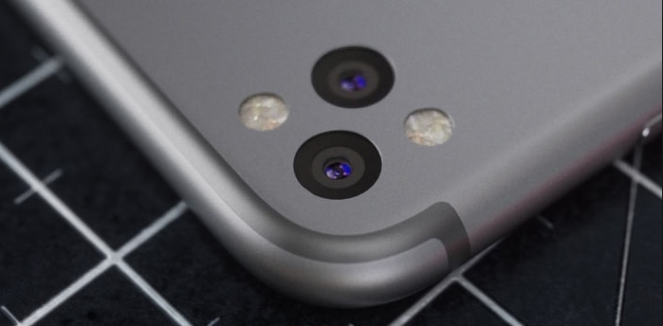
iPhone 7
13 megapixel primary camera.
8 megapixel secondary camera as well.

Slide 7

iPhone 7
iPhone 7 Water as well as dust proof. According to the rumors, the phone will be waterproofed to iP67

Slide 8
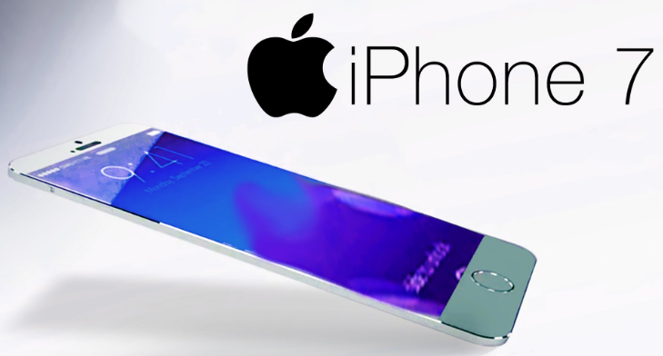
iPhone 7
iPhone 7 may fall between the price range of 800-900 USD depending upon different locations and GB memory.

Slide 9
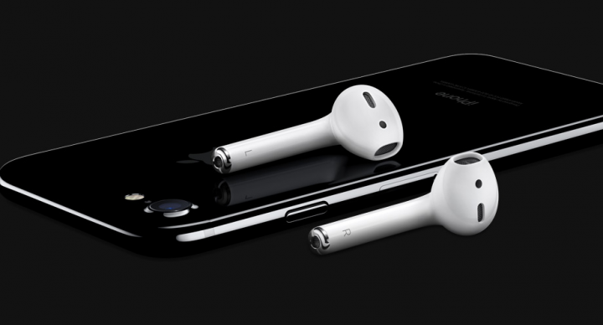
iPhone 7
Airpods
Wirelessly and effortlessly as if by magic

Slide 10
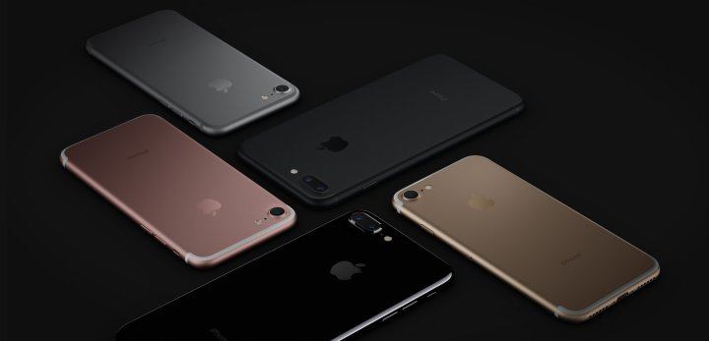
iPhone 7
Two sizes. Five finishes.
With iPhone 7 and iPhone 7 Plus, we’re introducing a beautiful black with a matte finish and a deep, high-gloss jet black. Both the 4.7 inch and 5.5 inch models constructed with incredibly strong 7000 Series aluminum are also available in our signature silver, gold, and rose gold finishes.

Slide 11
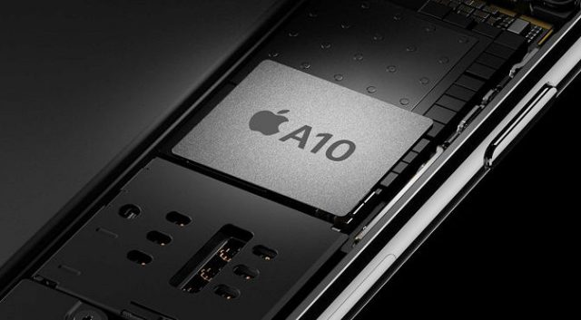
iPhone 7
iPhone 7 is supercharged by the most powerful chip ever in a smartphone. It’s not just faster than any previous iPhone it’s also more efficient. That’s because the A10 Fusion chip uses an all new architecture that enables faster processing when you need it, and the ability to use even less power when you don’t. And with the longest battery life ever in an iPhone, you can work at twice the speed of iPhone 6 and still enjoy more time between charges.

Slide 12

Software iOS 10. It’s why there’s nothing else like an iPhone.
iPhone 7

Slide 13
http://www.apple.com/iphone-7/
iPhone 7
THANK YOU VERY MUCH FOR YOUR ATTENTION

